Slide 1
Software Technology Presentation
Kuenga Palden
U3260636

Slide 2
Table of Content
Problem statement | Slide 3
Data description / showing | Slides 4
EDA | Slides 5 – 12
PDA | Slide 13 - 15
Implementation plan | Slide 16
Conclusion / Reference | Slides 17 - 18

Slide 3
Problem Statement
Skin Cancer Binary Classification Dataset (Kaggle)
Skin Cancer is widespread and potentially life-threatening
Can be treated effectively if it is diagnosed early
Ability to distinguish between cancerous and noncancerous
Reduce the rates of fatalities
Using the binary classification model we can identify:
Cancerous and non-cancerous images using a dataset of JPG images

Slide 4
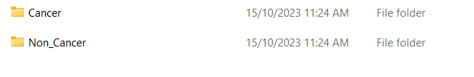
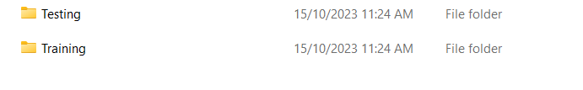
Dataset Description
Type of data: JPG Varies between each images ( 200 x 200, 380 x 380, 500 x 550, 1090 x 1180 ) Data format: JPG
Number of Images: A total of 288 Images ( Non-Cancer Testing folder containing 162 Images )
Number of classes: 2 classes in skin data with an additional 2 folders within cancer or non cancerous each labelled training and testing

Slide 5
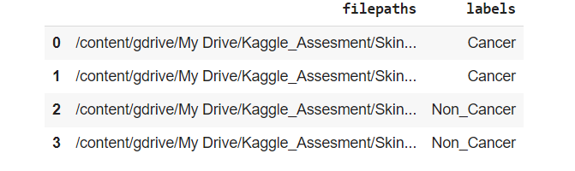
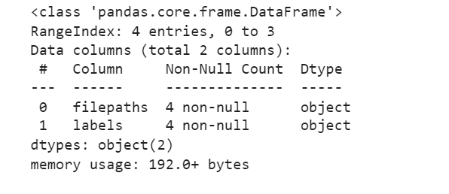
EDA Analysis
Q.1 How is the data distributed

Slide 6
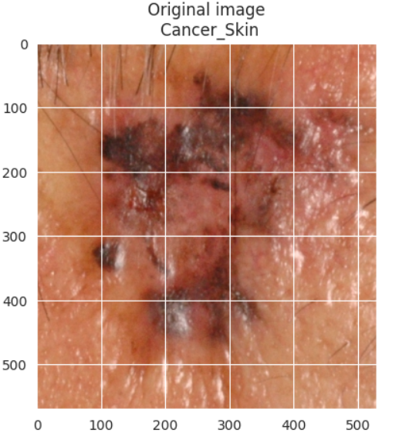
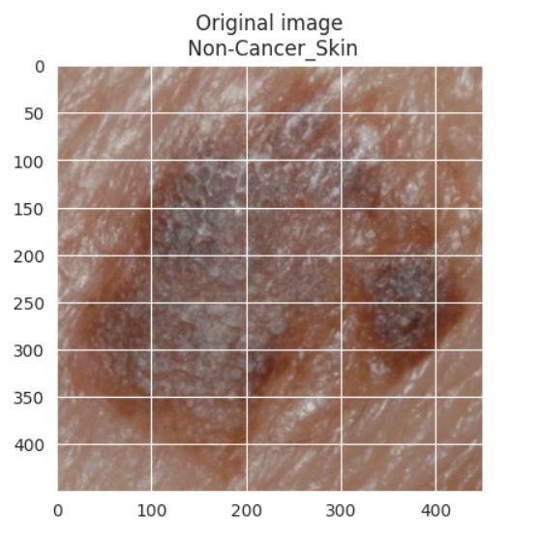
EDA Q2. How do Images from different class look like

Slide 7
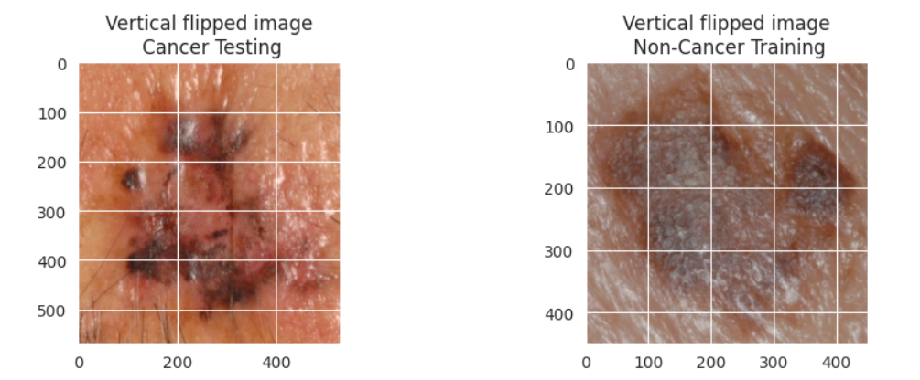
EDA Q3. Image viewing with geometrical transform (Vertical flipping)

Slide 8
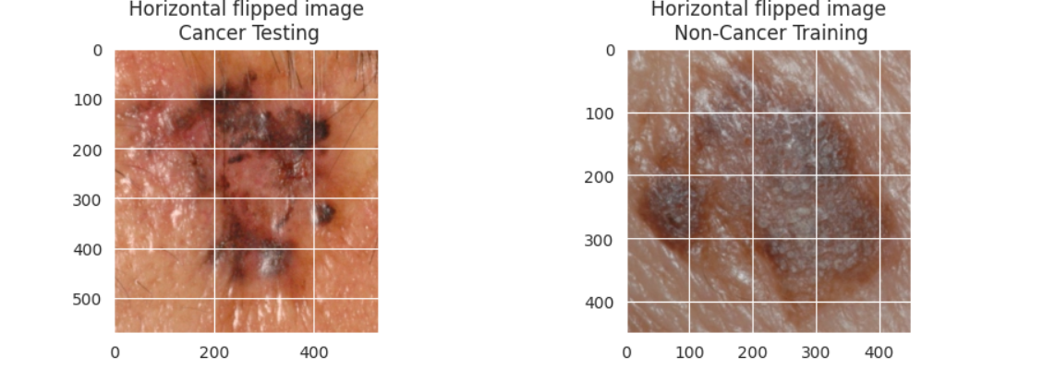
EDA Q3. Image viewing with geometrical transform (Horizontal flipping)

Slide 9
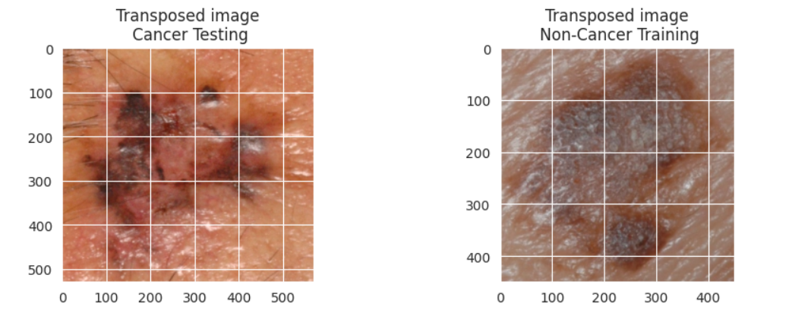
EDA Q3. Image viewing with geometrical transform (Transposed Image)

Slide 10
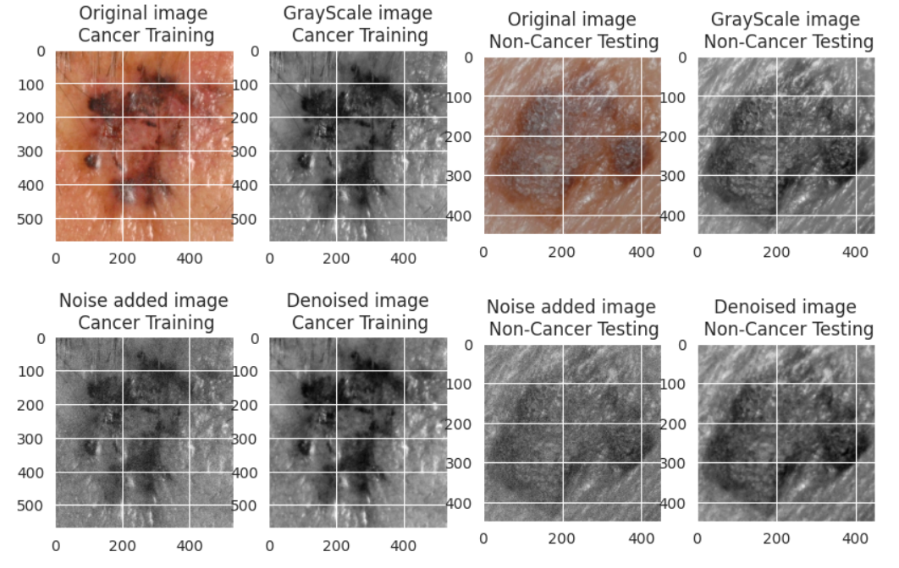
EDA Q4. Impact of noising and denoising operation on image quality

Slide 11
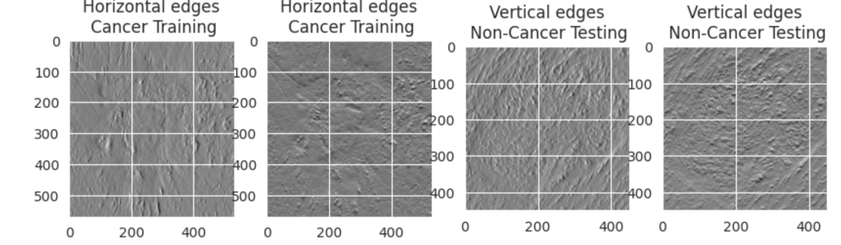
EDA Q5- How discriminative are the salient features such as edges and corners for images corresponding to each class

Slide 12
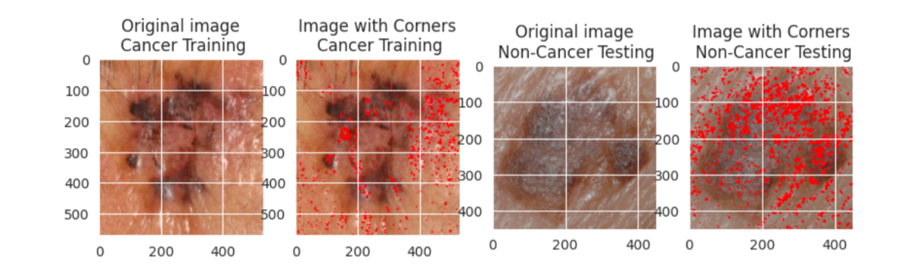
EDA Q5- How discriminative are the salient features such as edges and corners for images corresponding to each class

Slide 13
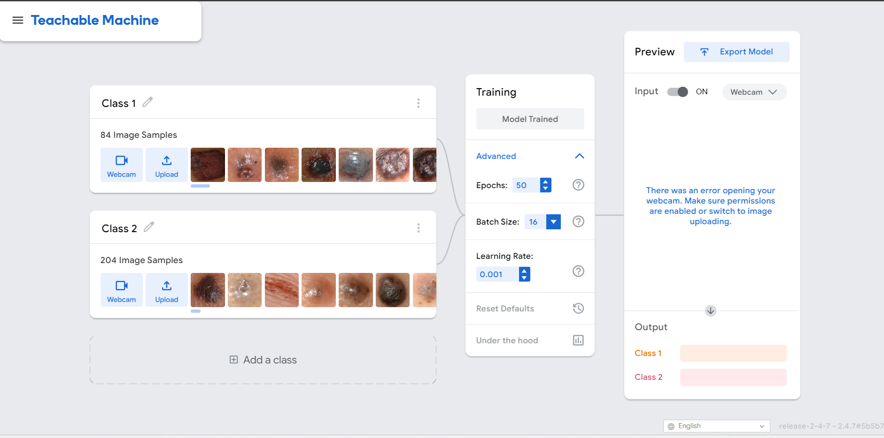
PDA (Via TM)

Slide 14
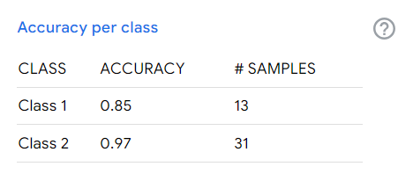
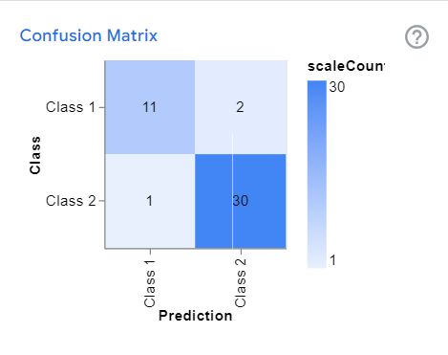
PDA (TM Continued)
URL: https://drive.google.com/file/d/1S_idsazSbHTIiQc5uAfj307UN0xvPHos/view?usp=share_link
Link to the teachable machine Model

Slide 15
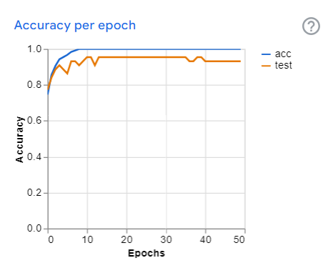
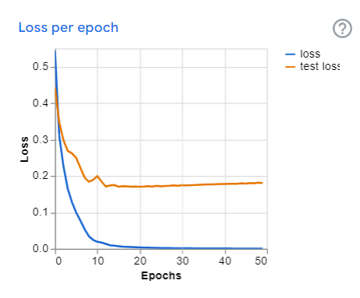
PDA (TM Continued)

Slide 16
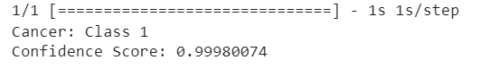
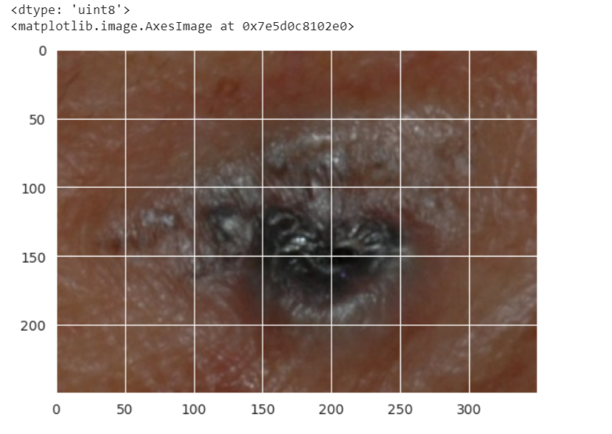
Deployment / Implementation (TM)

Slide 17
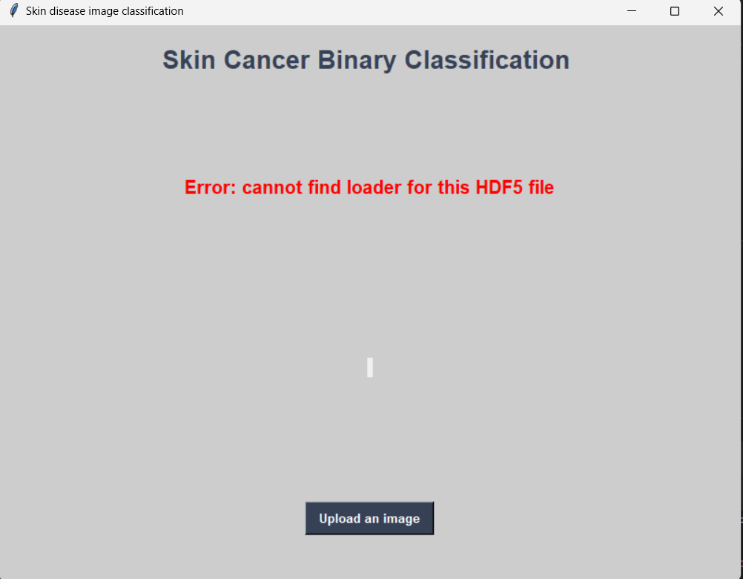
Tkinter implementation/plan
TensorFlow is not installing properly

Slide 18
Conclusion
THANK YOU
FOR LISTENING

Slide 19
References
K. Graupe, “Skin Cancer Binary Classification,” Kaggle , Feb. 2023. https://www.kaggle.com/datasets/kylegraupe/skin-cancer-binary-classification-dataset (accessed Oct. 18, 2023).
‌

